Slide 1
Artificial Pancreas Simulator

Slide 2
Objective
Simulate a T1D patient:
Model Insulin, meals, exercise effects on glucose.
Model T1D patients individual variability.
Model patient day-to-day variability.
Test Artificial Pancreas systems:
Prototype novel controllers.
Evaluate performances and fine-tune algorithms.

Slide 3
Characteristics
A modular, open-ended-design.
Easily manipulated framework, but not necessarily a complete solution.
has a minimal working setup, but support a lot of configuration for the full experience.
Usable by expert and non-expert users.
GUI vs command line.

Slide 4
Architecture
Simulator
Results Manager
Virtual Patient
Meal Plan
Exercise Plan
Controller
Infusions
glucose

Slide 5
Configuration
Simulation Start Time
Simulation Duration
Simulation Step Size
Virtual Patients:
patient model
meal plan
exercise plan
controller
Result Manager

Slide 6
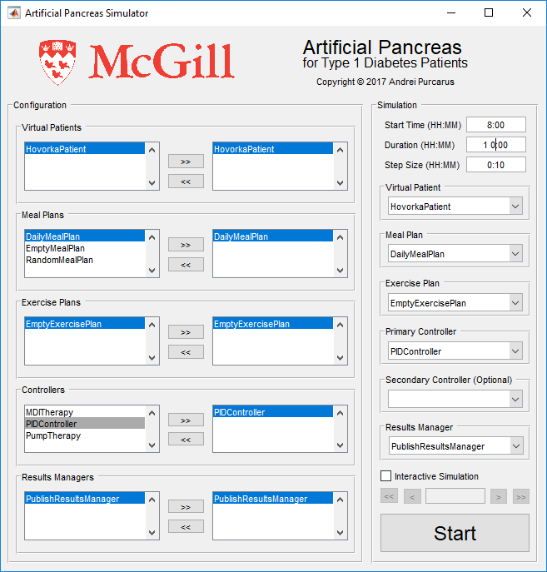
GUI

Slide 7
Process
For each time: from start until start + duration
Call the controller: getInfusions.
Call the patient model: updateState.
At the end: displayResults.

Slide 8
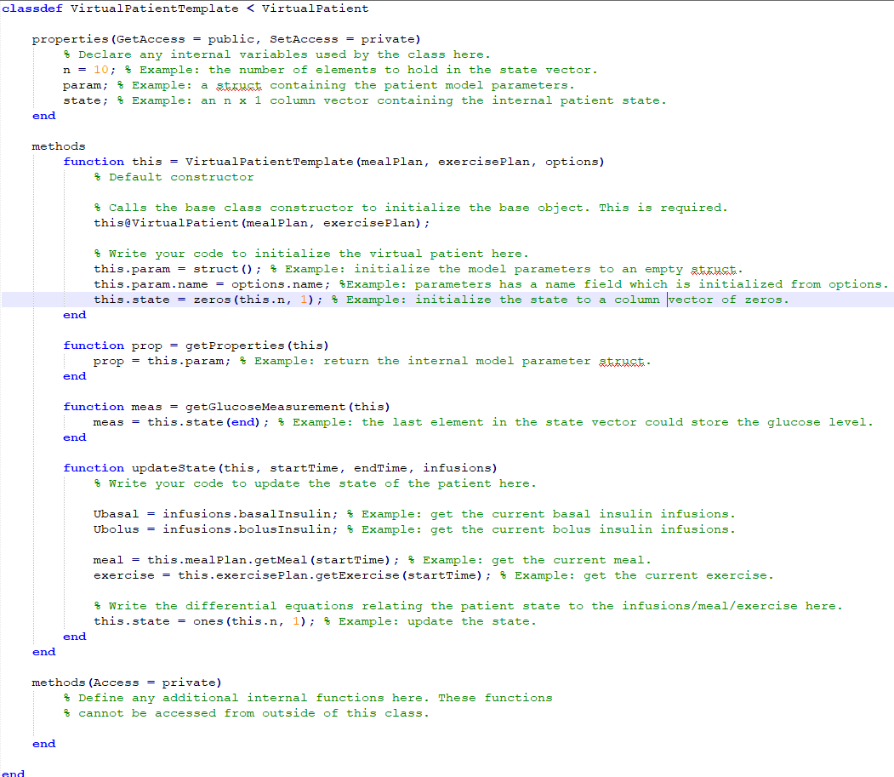
VirtualPatient

Slide 9
VirtualPatient

Slide 10
VirtualPatient

Slide 11
VirtualPatient

Slide 12
VirtualPatient

Slide 13
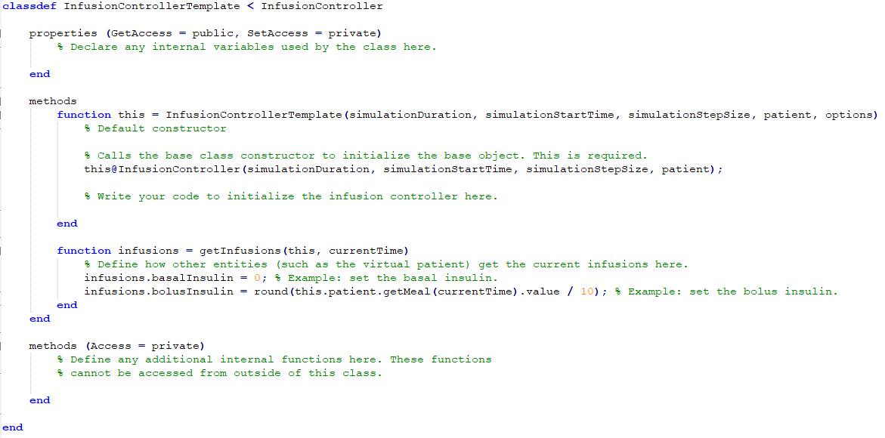
PrimaryController

Slide 14
Command line
-> MATLAB

